Slide 1

Automatic Detection and Classification of Diabetic Retinopathy Stages in Retinal Image
Presented by:
Md. Abrar Labib (144423)
Saquib Irtiza (144431)
Supervisor:
A. B. M. Ashikur Rahman
Lecturer, IUT

Slide 2
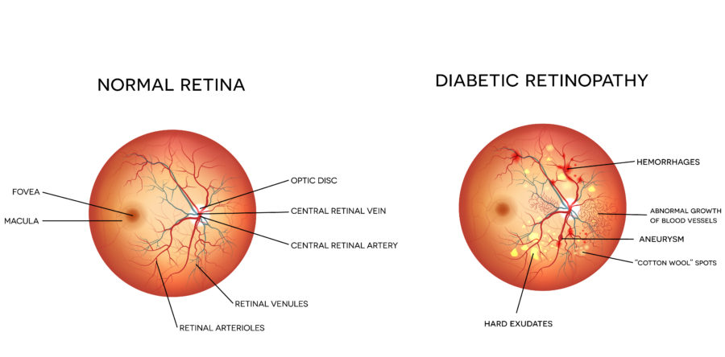
WHAT IS DIABETIC RETINOPATHY?
Disease that causes patients with diabetes to lose eyesight.
Small lesion appears in the retina of the patient’s eye.
It is one of the biggest reason for blindness.
Ophthalmologists can detect this disease from retinal images.
It can be avoided if detected at an early stage.

Slide 3
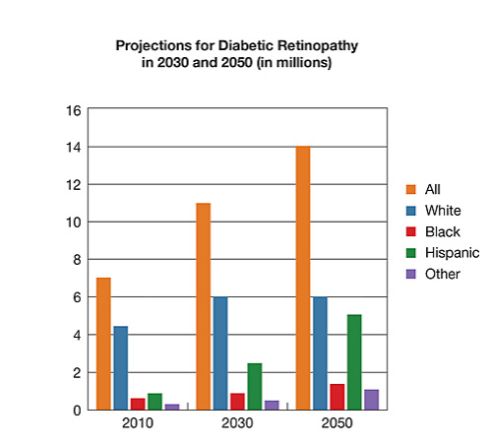
PROBLEM STATEMENT
[11]
Identifying lesion is a complex process.
Takes a lot of time before treatment.
Screening not available in remote places.
Ophthalmologists cannot often come to consensus.
Fastest growing reason for blindness.

Slide 4
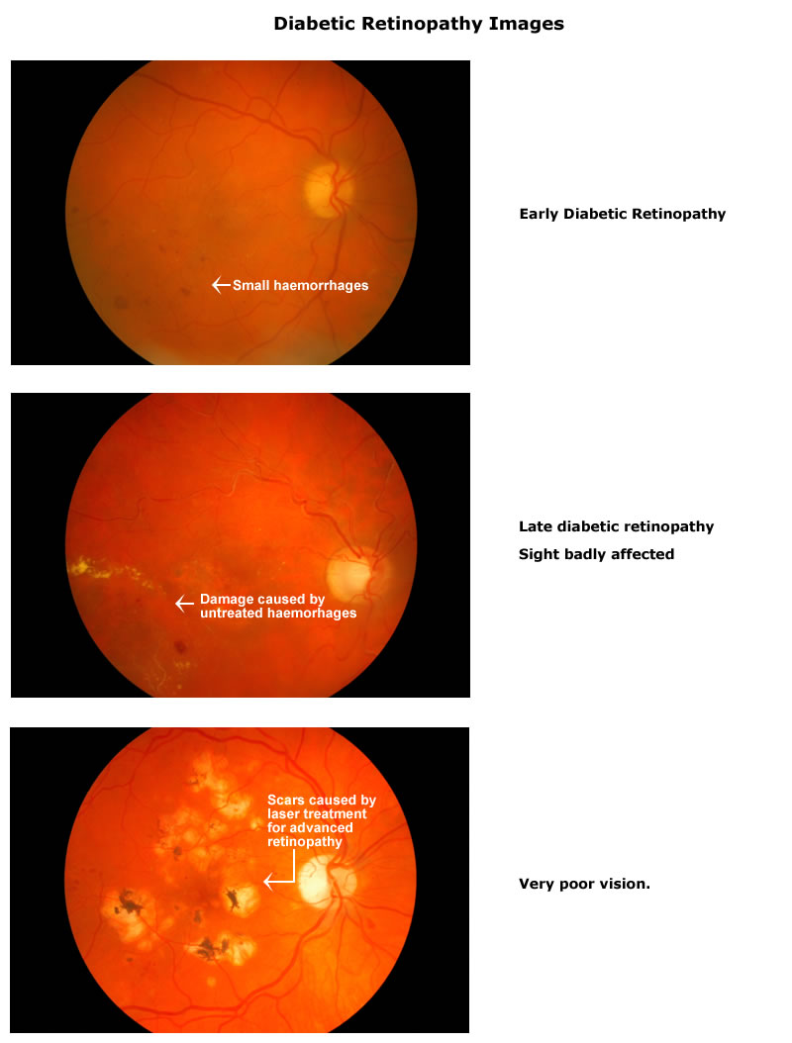
STAGES OF DIABETIC RETINOPATHY [12]
Stage 0: no DR
Stage 1: mild DR
Stage 2: moderate nonproliferative DR
Stage 3: severe nonproliferative DR
Stage 4: proliferative DR or Muscular edema(ME)

Slide 5
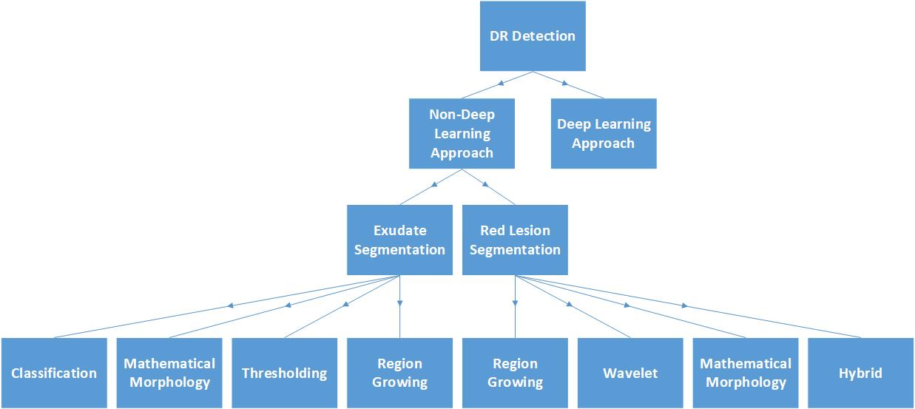
TAXONOMY OF METHODS [15]

Slide 6
NON-DEEP LEARNING APPROACHES
Literature Review
Typical steps involve:
Preprocessing, such as contrast enhancement
Removal of irrelevant objects, such as optic disks
Pathological features retained for classification
Two main indicators of DR:
White lesions – white or yellow blobs which are exudates or cotton-wool spots
Red lesions – small red spots which are micro-aneurysms or hemorrhages

Slide 7
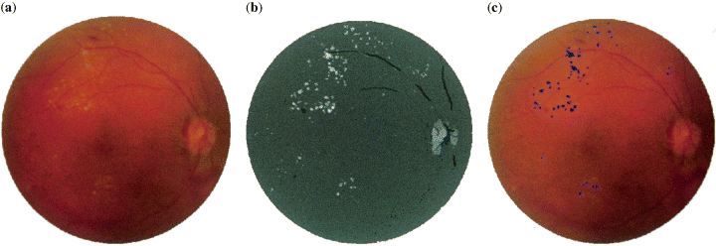
EXUDATE SEGMENTATION
Literature Review
Region Growing Method:
Regions of interest are segmented using spatial contiguity to separate from irrelevant regions
Adjacent pixels considered identical if they share similar features such as color or grey level intensities
Algorithms such as recursive region growing segmentation (RGGS) are used
Exudate recognition by RGGS (Sinthanayothin et al 2008 [1])

Slide 8
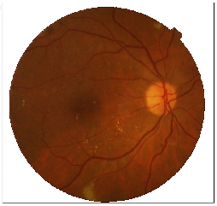
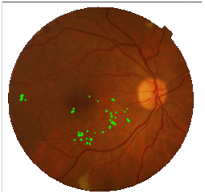
EXUDATE SEGMENTATION
Literature Review
Thresholding Method:
Exudate identification performed based on global or adaptive grey level analysis
Color information such as the modified RGB model are used to define feature space
Dividing the image into homogeneous regions, then adaptive thresholding each region
Exudate identification based on color model
(Sanchez et al 2008 [2])

Slide 9
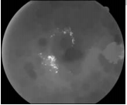
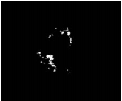
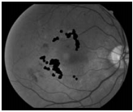
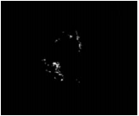
EXUDATE SEGMENTATION
Literature Review
Mathematical Morphology Methods:
Morphological operators such as opening, closing to detect structures with defined set
Morphological reconstruction followed by filtering and thresholding for large EXs
Top-hat operator applied to green channel to recover small EXs
A B C D
A)Preprocessed image B)mask of large EX C)candidate green channel set to 0 D)large candidate detection
(Zhang et al 2014 [3])

Slide 10
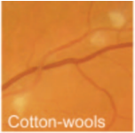
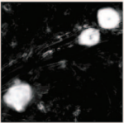
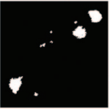
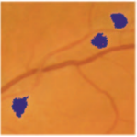
EXUDATE SEGMENTATION
Literature Review
Classification Methods:
Machine learning approaches such as SVM, NN, k-NN, fuzzy to classify candidates
Classified based on extracted features such as color representation, local properties
Supervised methods such as assigning probability maps according to annotated data
High probability pixels clustered together, classified on cluster characteristics
A B C D
A)Original Image B)Posterior probability map C)Probable pixel clusters D)Classification
(Niemeijer et al 2007 [4])

Slide 11
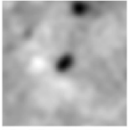
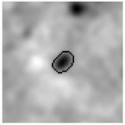
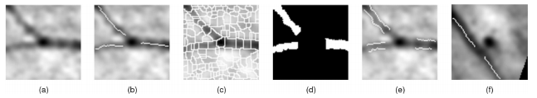
RED LESION SEGMENTATION
Literature Review
Region Growing Methods:
Region growing on a watershed gradient to identify candidate
Candidates discriminated from vasculature by top-hat transformation
then segmented via a region growing algorithm
Region growing at a MA, defined as the largest 8-connected region
(Fleming et al 2006 [5])
(a) MA candidate in vessel
(b) Vessel segments
(c) Watershed regions
(d) Region filling
(e) Edges of filled regions pass through MA
(f) Edges don’t pass through MA
(Fleming et al 2006 [5])

Slide 12
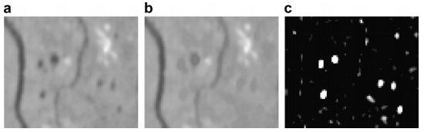
RED LESION SEGMENTATION
Literature Review
Mathematical Morphology Methods:
Morphological techniques discriminate between MAs and background structure
Diameter closing removes MAs, the top-hat returns the MAs with highest contrast
Candidates are then extracted using size criteria
Classifiers such as ANN, k-NN used on feature set
Preprocessed image B) Diameter Closing C)Top-hat transformation
(Walter et al 2007 [6])

Slide 13
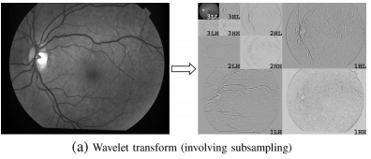
RED LESION SEGMENTATION
Literature Review
Wavelet-based Methods:
Based on template matching using wavelet transform
A window is moved over the image and subimages compared with parametric model
Images decomposed in subbands, each having specific information to describe MAs such as scale/frequency/direction
Wavelet transform function is highly adaptable to specific problems
Image subsampled into 3 bands at each level
Quellec et al 2008 [7]

Slide 14
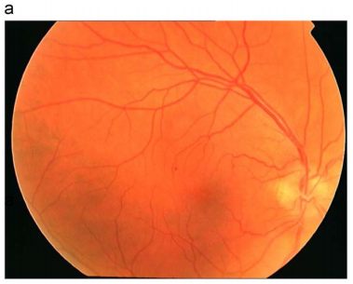
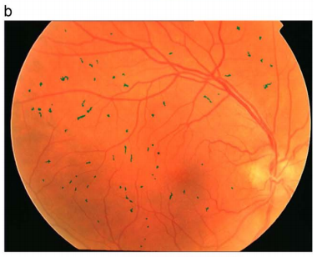
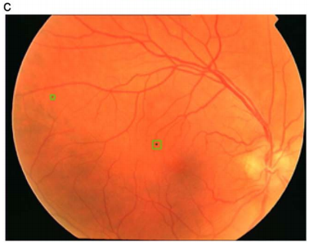
RED LESION SEGMENTATION
Literature Review
Hybrid Methods:
Combines segmentation methods to get optimal output
Segmentation steps such as morphology and pixel-based classification combined
Classification steps such as k-NN, ANN, SVM are compared and the best result selected
a)Original Image b)Coarse-level MA detection c)Fine-level MA detection
(Zhang et al 2010 [8])

Slide 15
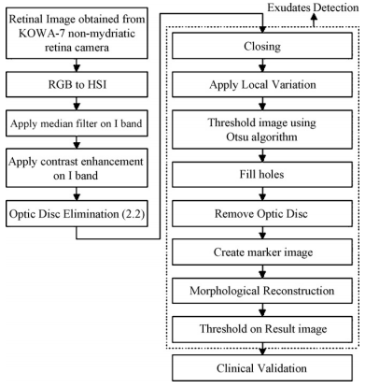
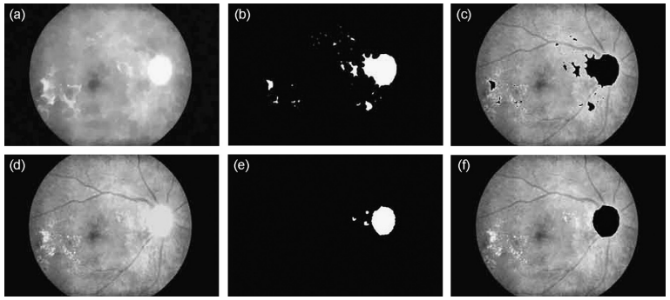
Literature Review
Optimally Adjusted Morphological Operators for Exudate Detection
By Sopharak et al 2010 [9]
Preprocessing:
I component can be separated in HSI
Median filtering on I reduces noise
Adaptive histogram equalization for contrast enhancement
Segmentation:
Optic disc must be removed as it is similar to exudates
Involves closing, thresholding, inversion, reconstruction, repeated dilation and difference
a)Blood vessels closed b)Thresholding c)Marker image
d)Reconstructed image e)threshold of difference f)disc removed

Slide 16
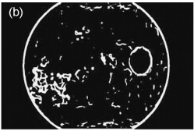
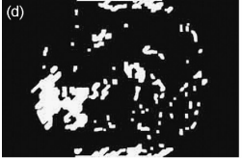
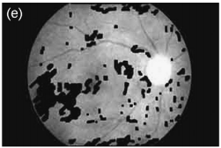
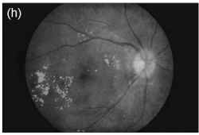
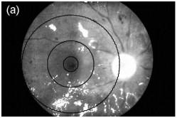
Literature Review
Optimally Adjusted Morphological Operators for Exudate Detection
Exudate detection:
After closing, local variation shows main characters of exudates
Candidate regions thresholded and flood filled, and used as mask for marker image after removal of optic disc
Mask morphologically reconstructed using dilation and superimposed on original
Macular detection:
High contrast vessels eliminated by closing, result binarized by thresholding
Darkest area near optic disk considered macular, exudate presence shows high severity
(c)
(d)
(e)
b) Thresholded local variation image
c) Flood fill & disk removal
d) Marker image
e) Difference superimposed on original
a) Exudates concentrated around macular

Slide 17
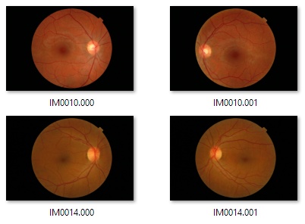
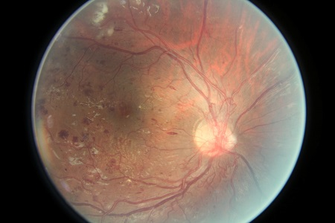
DEEP LEARNING IN DR [19]
Neural Network
Fed Into
Train
Training set of Images
Output
Put for test
Result
Retrained Module
Test Image

Slide 18
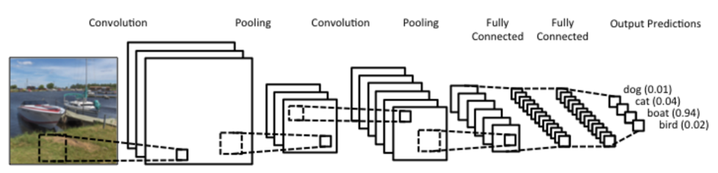
FUNDAMENTALS OF CNN
Deep, feed-forward artificial neural networks.
Designed to require minimal preprocessing.
Network learns the feature that in traditional algorithms were hand-engineered.

Slide 19
APPROACHES TAKEN BY OTHERS
Literature Review
Image pixel values were scaled and downsized, Gargeya et al [16]
Data augmentation using transformations such as rotation, flipping etc.
Use of different enhancement filters such as brightness and contrast enhancement.
Made sure that each class contains approximately the same number of images.
Validation set is kept similar to the test set.
Neural networks used are AlexNet, LeNet, OxfordNet, SparseConvNet and GoogleNet, Abramoff et al [20]
Some have merged different networks by ensembling them.

Slide 20
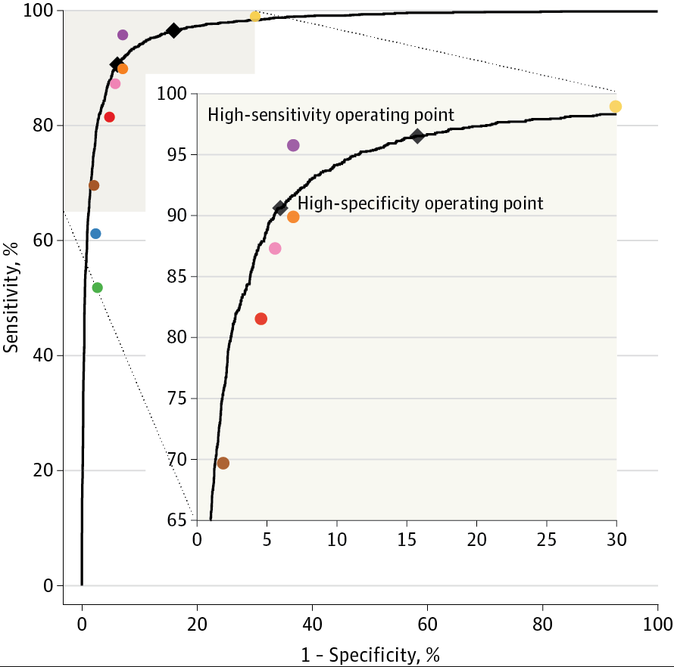
DR Classification using CNN
Literature Review
By Gulshan et al 2016 [10]
Dataset:
Algorithm Development Dataset: EyePACS-1 data set (9963 images)
Validation Dataset: Messidor-2 data set (1748 images)
Preprocessing:
Scale normalized by detecting the circular mask of the fundus image.
Resizing the diameter of the fundus to be 299 pixels wide.
Architecture:
Inception-v3 proposed by Szegedy et al. [17]
Optimization algorithm:
Distributed stochastic gradient descent implementation by Dean et al. [18]
Area under the curve: 97.4%.

Slide 21
DR Classification using CNN
Literature Review
Steps taken:
Batch normalization used to speed up training.
Dataset cross checked by multiple ophthalmologists.
Pre-initialization using weights from the other network (ImageNet dataset).
An ensemble of 10 networks trained on the same data was used.
Final prediction was computed by a linear average over the predictions of the ensemble.

Slide 22
IMPLEMENTATION & FUTURE WORK
Implementation:
Attempted to replicate methods of some participants of Kaggle DR Challenge (Team o_O [13] and JeffreyDF [14])
Used Python in Ubuntu OS
Libraries used: Theano, TensorFlow, Lasagne, OpenCV
Preprocessing steps were implemented successfully
Future Work:
Separation of training and validation datasets could be done before and after the augmentation to see how it performs.
Use different ensemble methods to merge the network formed by CNN to see which performs better.
Compare results of the above modifications with existing methods
Implement Inceptionv4 model on the current image set

Slide 23
REFERENCES
C. Sinthanayothin, J. F. Boyce, T. H. Williamson, H. L. Cook, E. Mensah, S. Lal, and D. Usher, “Automated detection of diabetic retinopathy on digital fundus images,” Diabetic medicine, vol. 19, no. 2, pp. 105–112, 2002.
C. I. S´anchez, R. Hornero, M. I. L´opez, M. Aboy, J. Poza, and D. Ab´asolo, “A novel automatic image processing algorithm for detection of hard exudates based on retinal image analysis,” Medical Engineering & Physics, vol. 30, no. 3, pp. 350–357, 2008.
X. Zhang, G. Thibault, E. Decenci`ere, B. Marcotegui, B. La¨y, R. Danno, G. Cazuguel, G. Quellec, M. Lamard, P. Massin et al., “Exudate detection in color retinal images for mass screening of diabetic retinopathy,” Medical image analysis, vol. 18, no. 7, pp. 1026–1043, 2014.
M. Niemeijer, B. van Ginneken, S. R. Russell, M. S. Suttorp-Schulten, and M. D. Abramoff, “Automated detection and differentiation of drusen, exudates, and cotton-wool spots in digital color fundus photographs for diabetic retinopathy diagnosis,” Investigative ophthalmology & visual science, vol. 48, no. 5, pp. 2260–2267, 2007.
A. D. Fleming, S. Philip, K. A. Goatman, J. A. Olson, and P. F. Sharp, “Automated microaneurysm detection using local contrast normalization and local vessel detection,” IEEE transactions on medical imaging, vol. 25, no. 9, pp. 1223–1232, 2006
T. Walter, P. Massin, A. Erginay, R. Ordonez, C. Jeulin, and J.-C. Klein, “Automatic detection of microaneurysms in color fundus images,” Medical image analysis, vol. 11, no. 6, pp. 555–566, 2007.
G. Quellec, M. Lamard, P. M. Josselin, G. Cazuguel, B. Cochener, and C. Roux, “Optimal wavelet transform for the detection of microaneurysms in retina photographs.” IEEE Transactions on Medical Imaging, vol. 27, no. 9, pp. 1230–41, 2008.
B. Zhang, X. Wu, J. You, Q. Li, and F. Karray, “Detection of microaneurysms using multi-scale correlation coefficients,” Pattern Recognition, vol. 43, no. 6, pp. 2237–2248, 2010.
A. Sopharak, B. Uyyanonvara, S. Barman, and T. H. Williamson, “Automatic detection of diabetic retinopathy exudates from non-dilated retinal images using mathematical morphology methods,” Computerized medical imaging and graphics, vol. 32, no. 8, pp. 720–727, 2008.
V. Gulshan, L. Peng, M. Coram, M. C. Stumpe, D. Wu, A. Narayanaswamy, S. Venugopalan, K. Widner, T. Madams, J. Cuadros et al., “Development and validation of a deep learning algorithm for detection of diabetic retinopathy in retinal fundus photographs,” Jama, vol. 316, no. 22, pp. 2402–2410, 2016.

Slide 24
REFERENCES
National Eye Institute (NEI), https://nei.nih.gov/eyedata/diabetic
“Kaggle datasets: Diabetic retinopathy detection,” accessed: 2016-10-05. [Online]. Available: https://www.kaggle.com/c/diabetic-retinopathy-detection/data
Team o_O 2nd place Solution, https://github.com/sveitser/kaggle_diabetic
JeffreyDF 5th place Solution, https://github.com/JeffreyDF/kaggle_diabetic_retinopathy
Valverde, C., Garcia, M., Hornero, R., & Lopez-Galvez, M. I. (2016). Automated detection of diabetic retinopathy in retinal images. Indian journal of ophthalmology, 64(1), 26.
R. Gargeya and T. Leng, “Automated identification of diabetic retinopathy using deep learning,” Ophthalmology, vol. 124, no. 7, pp. 962–969, 2017.
Szegedy, Christian, et al. "Rethinking the inception architecture for computer vision." Proceedings of the IEEE conference on computer vision and pattern recognition. 2016.
Dean, Jeffrey, et al. "Large scale distributed deep networks." Advances in neural information processing systems. 2012.
Szegedy, Christian, et al. "Going deeper with convolutions." Proceedings of the IEEE conference on computer vision and pattern recognition. 2015.
M. D. Abr`amoff, Y. Lou, A. Erginay, W. Clarida, R. Amelon, J. C. Folk, and M. Niemeijer, “Improved automated detection of diabetic retinopathy on a publicly available dataset through integration of deep learning,” Investigative ophthalmology & visual science, vol. 57, no. 13, pp. 5200–5206, 2016.

